Slide 1

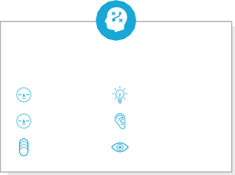




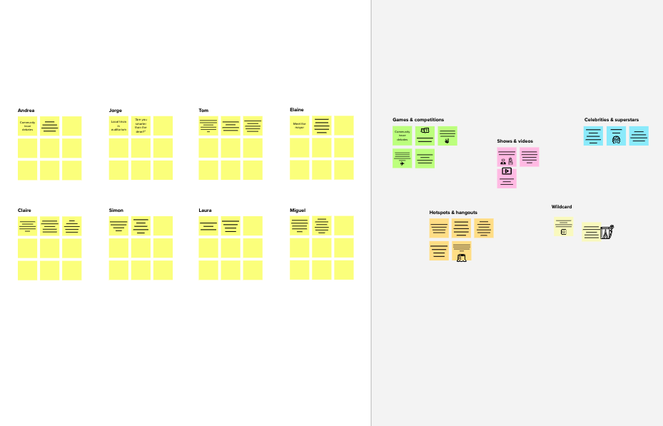




Template
Before you collaborate
A little bit of preparation goes a long way with this session. Here’s what you need to do to get going.
10 minutes
1
Define your problem statement
What problem are you trying to solve? Frame your problem as a How Might We statement. This will be the focus of your brainstorm.
2
Brainstorm
Write down any ideas that come to mind that address your problem statement.
3
Group ideas
Take turns sharing your ideas while clustering similar or related notes as you go. Once all sticky notes have been grouped, give each cluster a sentence-like label. If a cluster is bigger than six sticky notes, try and see if you and break it up into smaller sub-groups.
4
Prioritize
Your team should all be on the same page about what's important moving forward. Place your ideas on this grid to determine which ideas are important and which are feasible.
After you collaborate
You can export the mural as an image or pdf to share with members of your company who might find it helpful.
TIP
You can select a sticky note and hit the pencil [switch to sketch] icon to start drawing!
5 minutes
10 minutes
20 minutes
20 minutes
Brainstorm
& idea prioritization
Use this template in your own brainstorming sessions so your team can unleash their imagination and start shaping concepts even if you're not sitting in the same room.
_{A} Team gathering
Define who should participate in the session and send an invite. Share relevant information or pre-work ahead.
PROBLEM
Based on the user input the model should predict :
If the user has a thyroid disease or not what type of thyroid disease the user has
also predict the risk of user getting the disease
Person 1
Person 2
Person 3
Person 4
Quick add-ons
how to
how to
how to predict
collecting the data
preparing the data
analyzing the data
TIP
Add customizable tags to sticky notes to make it easier to find, browse, organize, and categorize important ideas as themes within your mural.
_{A} Share the mural
Share a view link to the mural with stakeholders to keep them in the loop about the outcomes of the session.
handle the training the ^{building the}
using the _{collecting} setting up
preparing ^{how to deal} predict the
displaying
what type of analyzing
collecting the data
preparing the data
training the model
using the ML
algorithm
how to predict the thyroid disease
incorrect model user data
flask application
ML the project
algorithm ^{the data} structure
the data
with the user data
thyroid disease
thyroid disease
message to _{the data}
_{B} Set the goal
Think about the problem you'll be focusing on solving in the brainstorming session.
the user
setting up the project structure
easy to use user interface
testing the model for any bugs
training the model
using the ML
algorithm
testing the model for any bugs
how to predict the thyroid disease
how to predict what type of thyroid disease
analyzing the data
testing the model for any bugs
how to predict what type of thyroid disease
easy to use user interface
B Export the mural
Export a copy of the mural as a PNG or PDF to attach to emails, include in slides, or save in your drive.
C
Learn how to use the facilitation tools
Use the Facilitation Superpowers to run a happy and productive session.
how to deal with the user data
how to handle the incorrect user data
displaying message to the user
how to deal with the user data
displaying message to the user
building the flask application
10 minutes to prepare
1 hour to collaborate
2-8 people recommended
Open article
Keep moving forward
Person 5
Person 6
Person 7
Person 8
setting up the project structure
easy to use user interface
building the flask application
how to handle the incorrect user data
Strategy blueprint
Define the components of a new idea or strategy.
Open the template
Key rules of brainstorming
To run an smooth and productive session
Customer experience journey map
Understand customer needs, motivations, and obstacles for an experience.
Open the template
Stay in topic.
Encourage wild ideas.
Importance
If each of these tasks could get done without any difficulty or cost, which would have the most positive impact?
Defer judgment.
Listen to others.
Strengths, weaknesses, opportunities & threats
Identify strengths, weaknesses, opportunities, and threats (SWOT) to develop a plan.
Open the template
Go for volume.
If possible, be visual.
TIP
Participants can use their cursors to point at where sticky notes should go on the grid. The facilitator can confirm the spot by using the laser pointer holding the H key on the keyboard.
Share template feedback
Share template feedback
Feasibility
Regardless of their importance, which tasks are more feasible than others? (Cost, time, effort, complexity, etc.)
Need some inspiration?
See a finished version of this template to kickstart your work.
Open example

